Slide 1
Airflow Run-Through
GPDNA

Slide 2
AGENDA
Introduction
Docker
Airflow
Set-Up
Process
Challenges
Running Airflow
DAG Scripts
Module Installations
Communications with Containers

Slide 3


INTRODUCTION

Slide 4
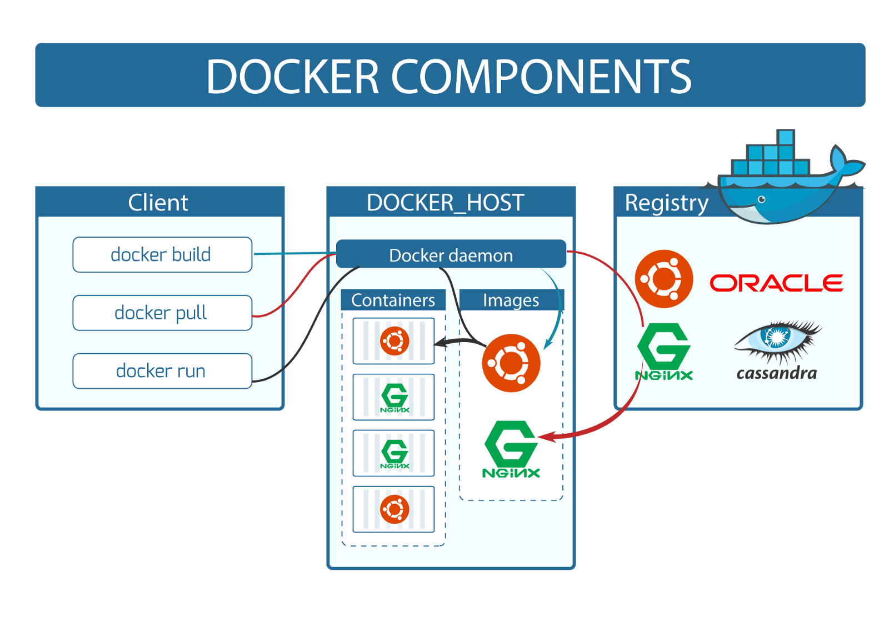

Docker
Dockerfile
A script that defines the configurations of the virtual machine
Control the scripts to be ran when the container is booted
Images
Configured environments
Defined using a Dockerfile
Containers
Light-weight virtual machines
Applications are ran in Containers

Slide 5
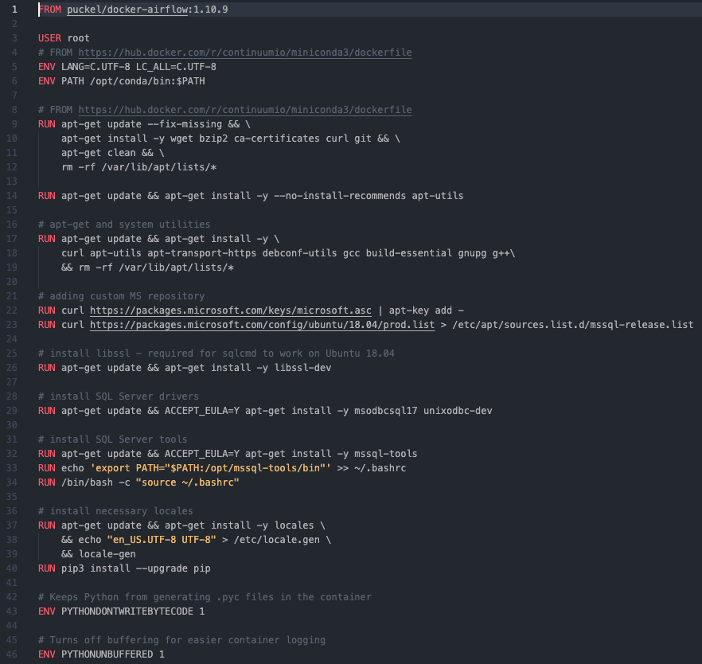
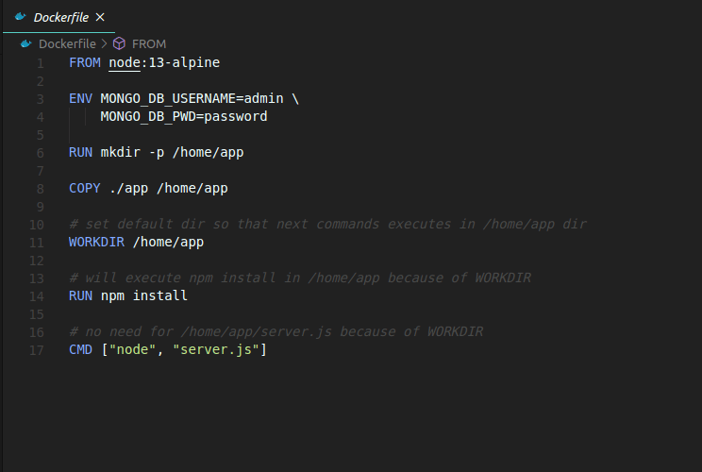
Dockerfile

Slide 6
Airflow

Slide 7
SET-UP

Slide 8
Process
Services
Airflow
DAG
Docker-Compose
DAG Config
Worker
PostgreSQL
ETL Logic
Celery

Slide 9
Challenges
Company Proxy
Building images blocked
Public repositories
Able to load fully-build images
PYODBC
Communicate with MSSQL Server
Developed for Windows or Mac
No compiled package for Linux Core
Sample Code
MSSQL Driver
Typical drive not usable in Linux core
Use: “xxxxx” instead

Slide 10
RUNNING-AIRFLOW

Slide 11
Requests

Slide 15
Chart Example 1

Slide 17
Micron 3.1 Color Palette
Micron Logo
Primary
Charts & Graphs
Status only
l
= l (Wingdings)
p
= p (Wingdings 3)
u
= u (Wingdings)
Visit the Brand Portal (alias: brandportal/) to access additional logos, icons, and PowerPoint resources.

